Slide 1
Foodie app
manage your food smarter
by Hax0rs team: Adam Tomaja, Piotr Jaworski, Daniel Jankowiak

Slide 2
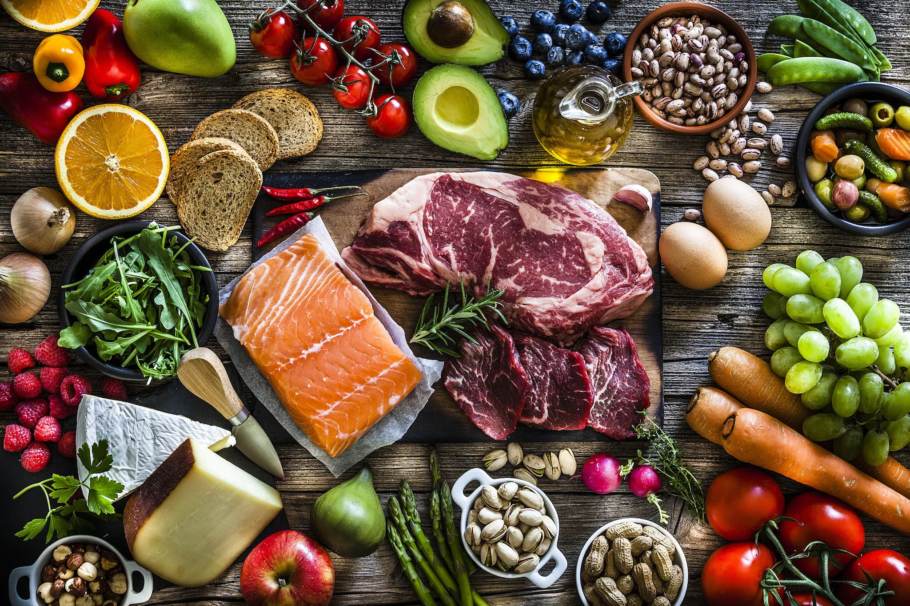
How we can reduce food waste ?
Stop throwing food because it is after expiration date
Buy only things that you need and be more aware
Track what you actually have instead buying it and realizing that you already have some product in the fridge

Slide 3
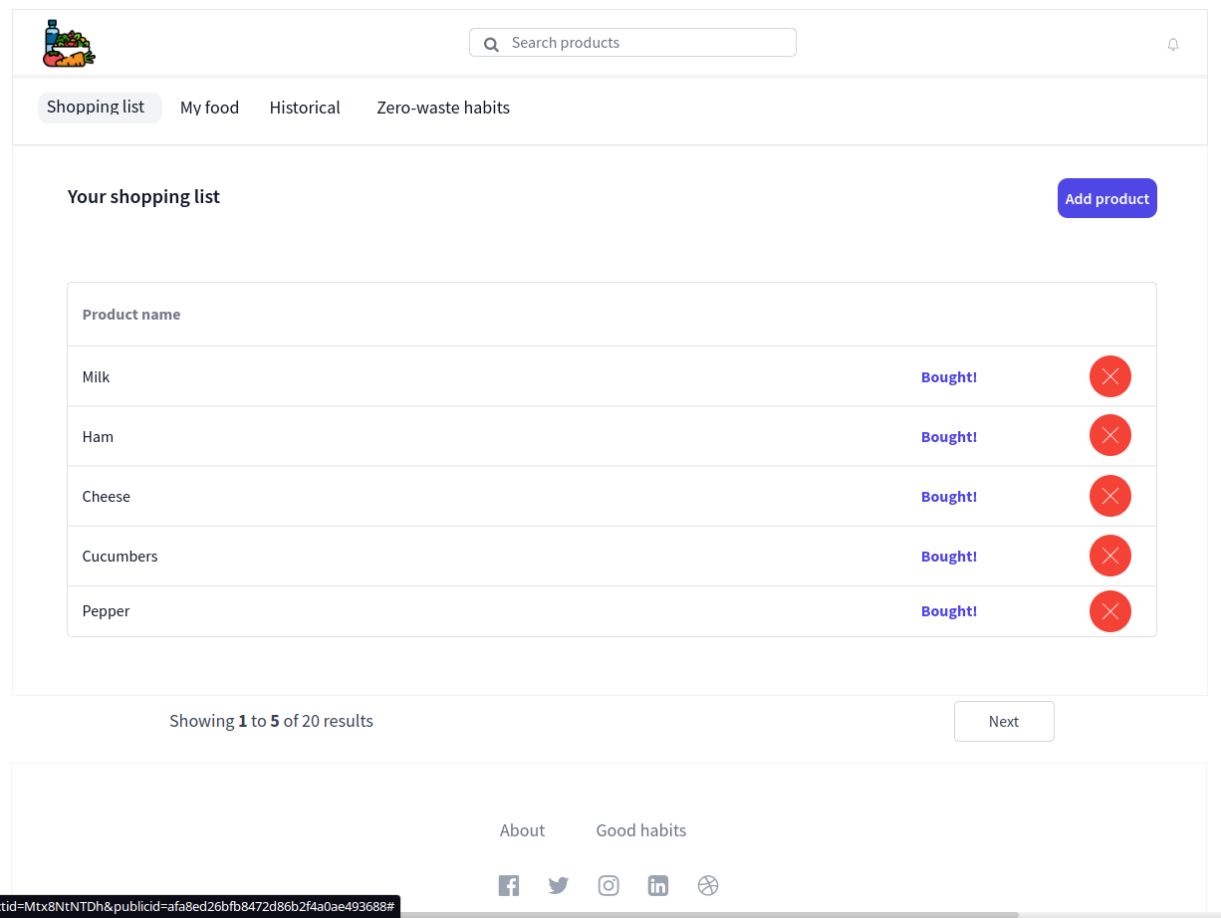
Foodie app shopping list
Let`s do shopping with already defined list
When shopping You can move product to ‘My Food’ list or remove it

Slide 4
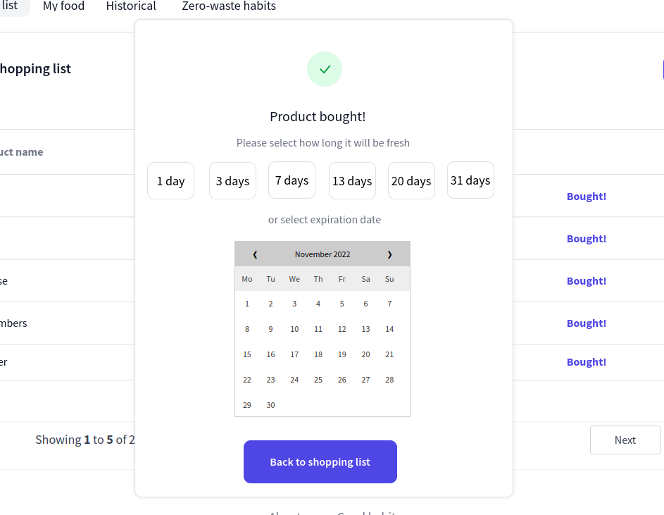
Add bought products to ‘My food’ list and define expiration date
Use your shopping list and just click “Bought” and define expiration date

Slide 5
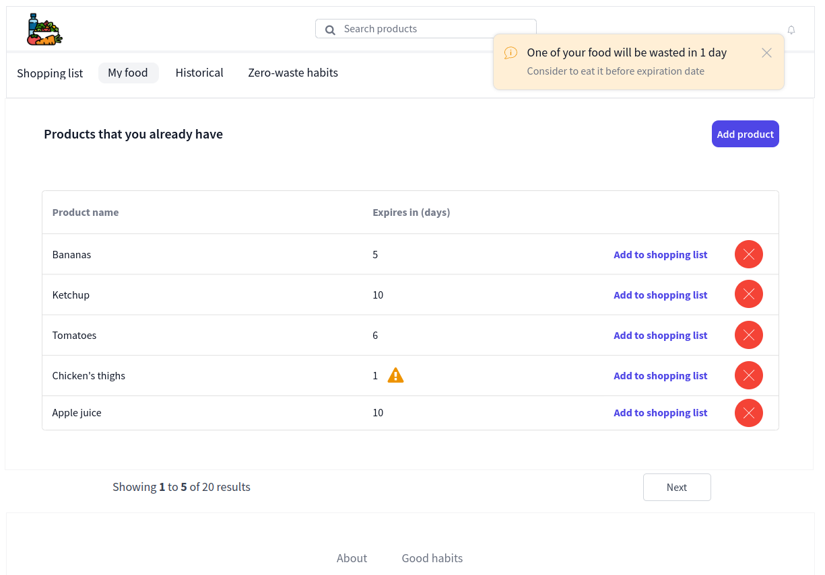
Be aware of products freshness
App will notify You when some product is about to waste
Because of that You will be able to eat it before it will be wasted
Consumed products can be added to shopping list with one click

Slide 6
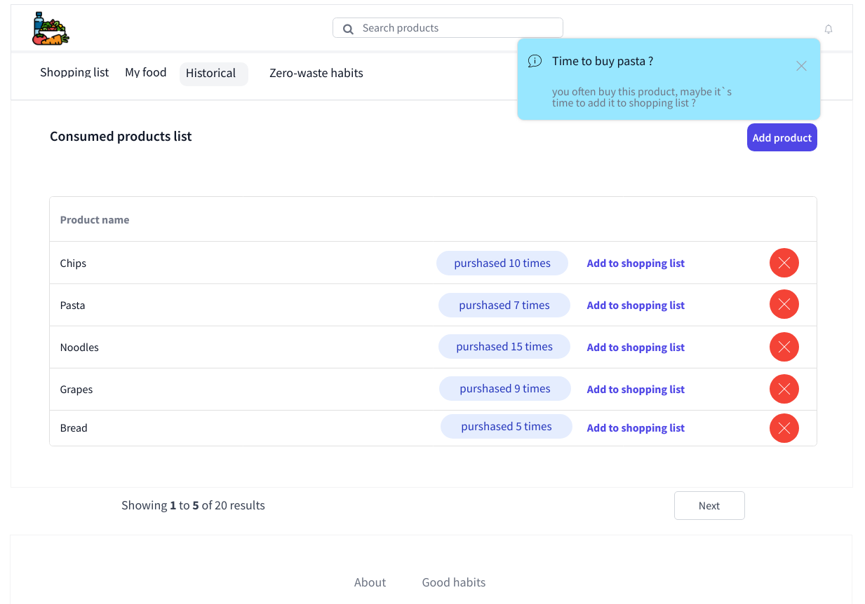
App will also remind you that you should buy product that you often bought in the past
When you deleting the product from shopping list or ‘My food’ it will end up in historical list
When you buying some product regularly the app will remind you that it is time to add it again to the shopping list

Slide 7
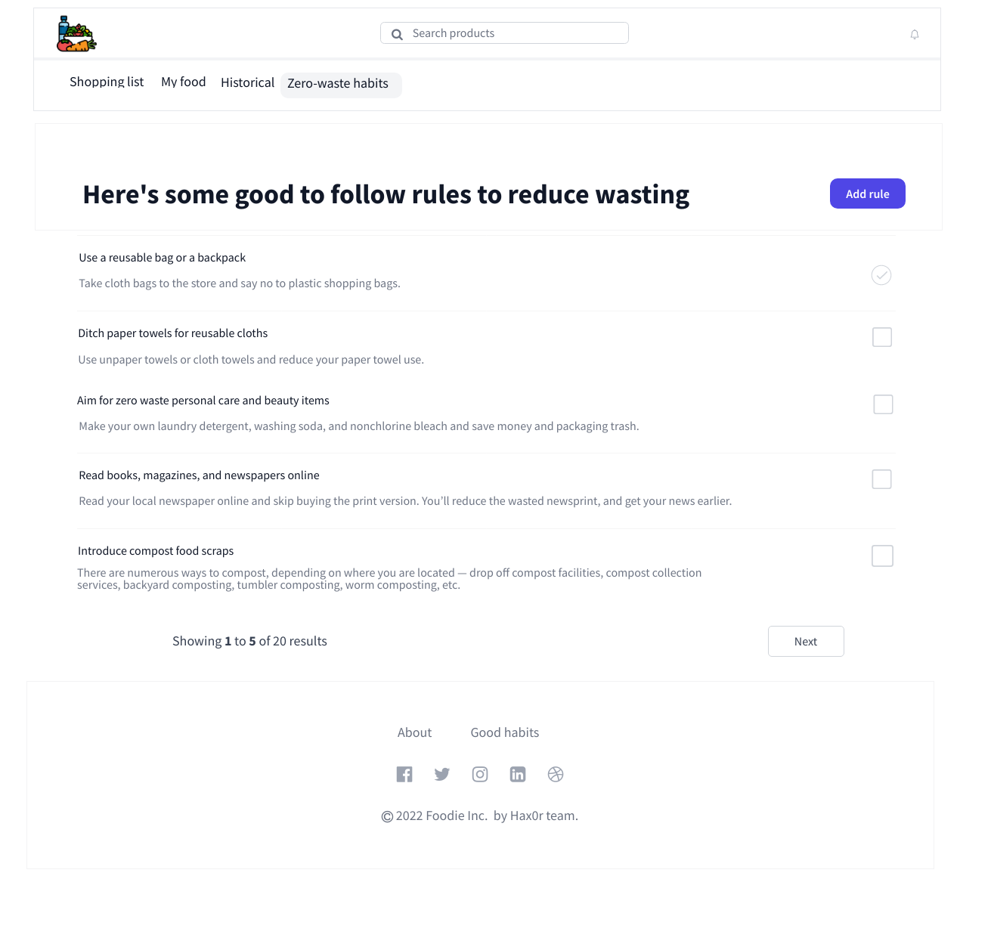
You can also view some good-to-follow habits to reduce waste
Every habit have title and description with details about it.
There is possibility to mark rules that have been introduced in life by checkbox on right side

Slide 8
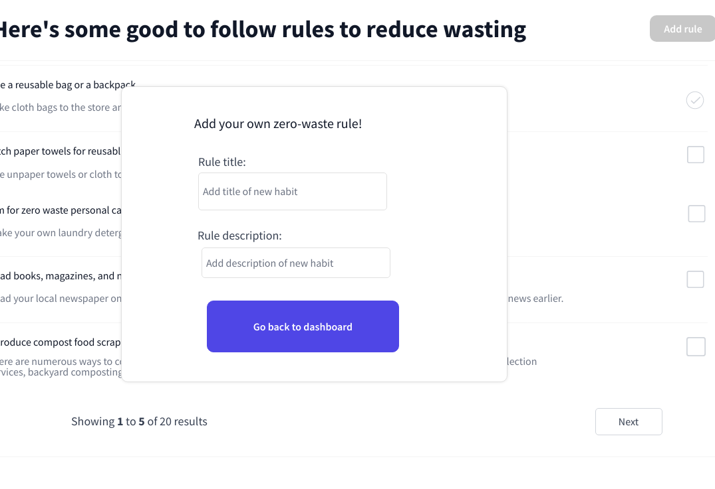
It is possibility to add your own good habit
After click “Add rule” button the popup will show up.
You have to define title and description of rule

Slide 9
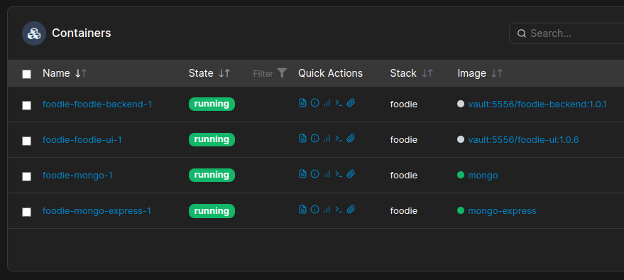
Prototype implementation details
Backend written in Spring Boot - Java
Application data stored in MongoDB database
Frontend implemented in React, Tailwind CSS, daisyUI, Axios
Deployment in our private server using containers - Docker-Compose
Stack management: Portainer-be

Slide 10
Checkout our demo and repository!
Demo application: https://foodieapp.duckdns.org
Github repository:
https://github.com/AdamTomaja/hackandbecool
Thank you for attention :)

